Slide 1

Data Visualization
Sajjan Adhikari

Slide 2
Introduction
The process of finding trends and correlations in our data by representing it pictorially
Data visualization is a field in data analysis
it is especially useful when we have large data sets
it can be difficult to truly understand your data when it’s just in tabular form

Slide 3
Why do we visualize data?
Decision-Making
Insights provided by visualization helps in decision making
Enhances Data Understanding
It allows us to see patterns, trends, and relationships in data
Simplifies Complex Information
Effective Storytelling

Slide 4
Most popular tool?
Microsoft Power BI
Tableau
IBM Watson
Dundas BI

Slide 5
Data visualization in Python
Python offers several plotting libraries
Matplotlib
Seaborn
Plotly
aw

Slide 6
Diagrams
Commonly used diagrams
Bar chart
Histogram
Line Chart
Scatter Plot
Box Plot
Pie Chart
Heatmap
Word Cloud
3D Scatter Plot

Slide 7
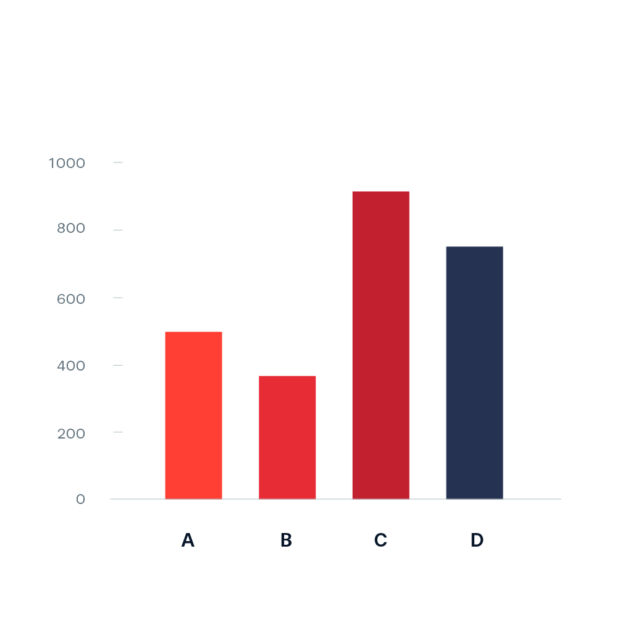
Bar chart
Displays categorical data with rectangular bars
Useful for comparing categories or showing distribution

Slide 8
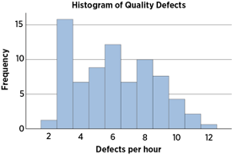
Histogram
to show frequency of distributions
good for showing general distributional features of dataset variables

Slide 9
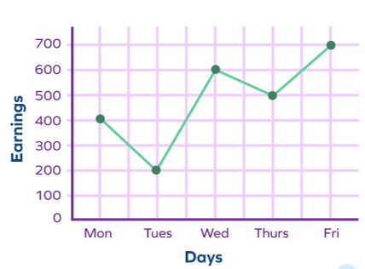
Line Chart
Shows data points connected by straight lines, typically used for visualizing trends over time or continuous data

Slide 10
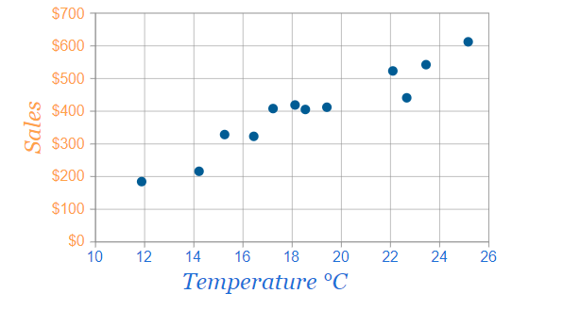
Scatter Plot
Displays individual data points as dots on a two-dimensional plane
useful for showing the relationship between two continuous variables

Slide 11
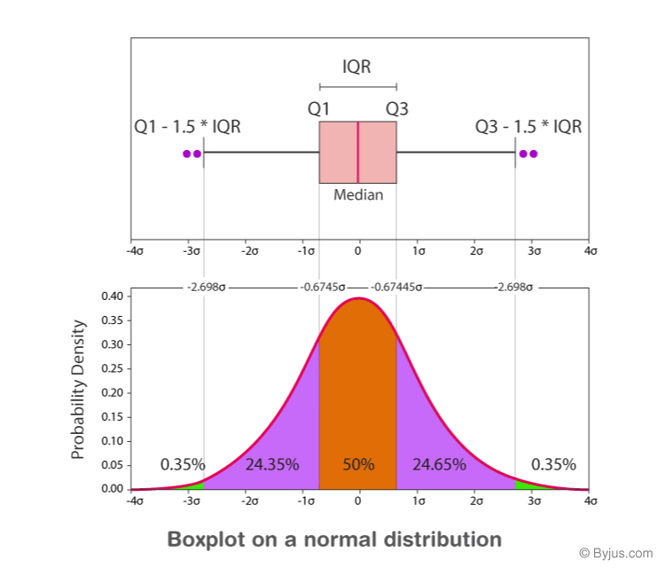
Box Plot
Provides a summary of the distribution of a dataset by displaying the median, quartiles, and potential outliers

Slide 12
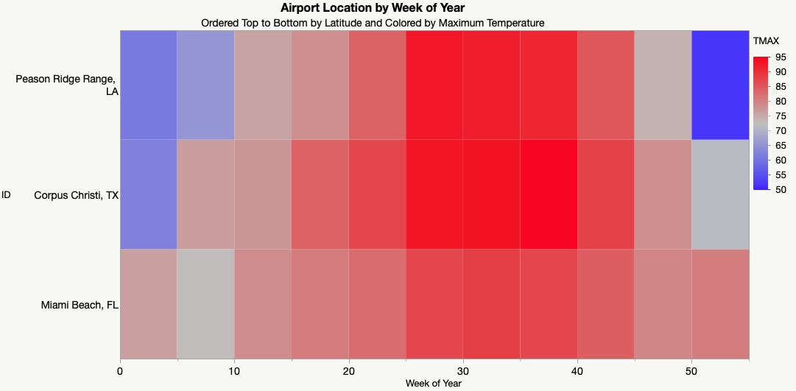
Heatmap
Uses color intensity to represent values in a matrix
often used for visualizing correlation matrices or 2D data

Slide 13
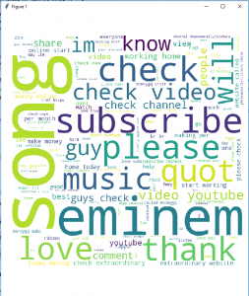
Word Cloud
Represents text data, where the size of each word is proportional to its frequency in the text

Slide 14
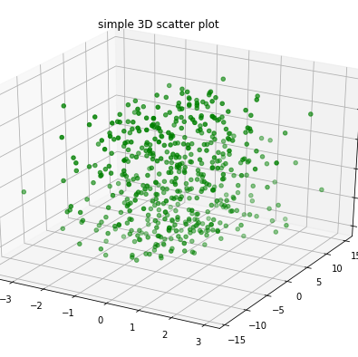
3D Scatter Plot
Extends the scatter plot into three dimensions

Slide 15
Thank You

